Slide 1

DriverPass System Analysis
Chris McLernon
Notes:
[No speaker notes required for this slide.]

Slide 2

System Requirements
Functional Requirements
The system shall validate user credentials when logging in, prompting for a valid username and password.
The system shall allow users to book reservations.
Non-Functional Requirements
During sign-up, users should create their own unique username and password, which should be case-sensitive for heightened security
The system should support a wide range of devices and operating systems to ensure accessibility for all users.
Notes:
System should support wide range of devices and operating systems for accessibility.
Cloud infrastructure eliminates need for additional tools or databases.
Cloud platform provides built-in security measures and database management.
Simplifies system deployment and maintenance while ensuring efficiency and security.
During sign-up, users create unique username and password (case-sensitive).
Multifactor authentication system adds extra layer of verification.
System should notify administrator of glitches, bugs, or performance issues.
Immediate notifications enable swift resolution and minimize disruptions.
Sign-up process allows custom usernames and passwords with case-sensitivity.
System promptly alerts administrator of issues for seamless user experience.

Slide 3
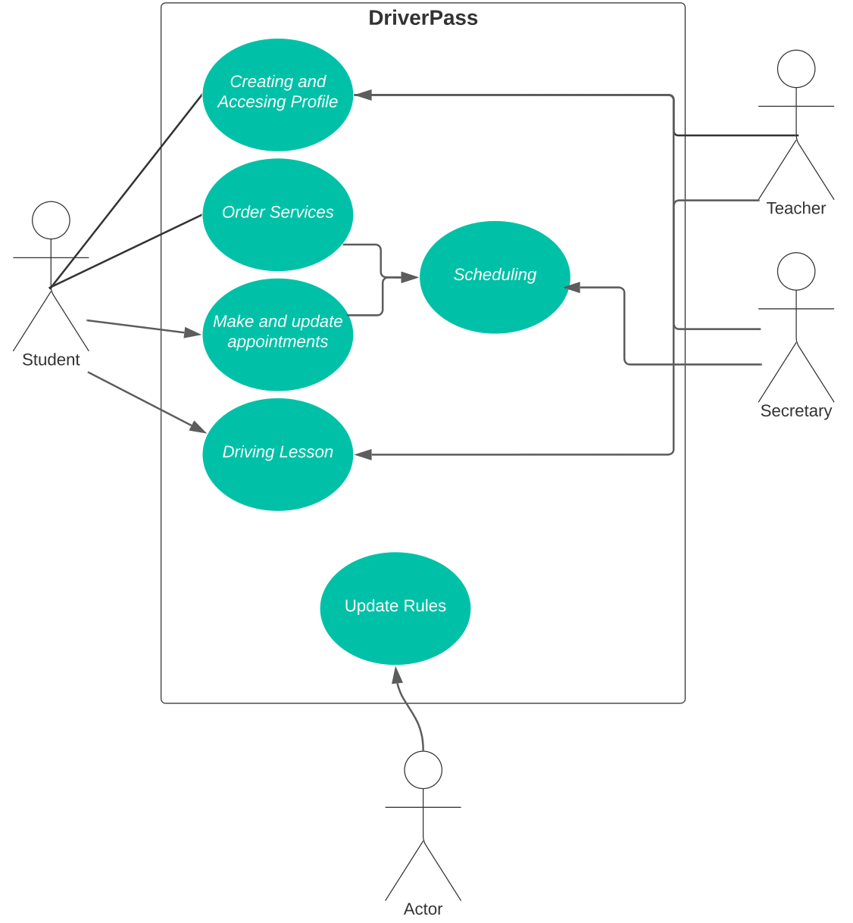
Use Case Diagram
Notes:
UML use case diagram for the DriverPass system:
Illustrates various actions and roles in the system.
Actors in the system:
Student:
Create and access profile.
Order services.
Manage appointments.
Take driving lessons.
Teacher:
Conduct driving lessons.
Schedule lessons.
Access profile.
Secretary:
Schedule appointments.
Manage profiles.
DMV:
Update rules and regulations.
Covers necessary use cases:
Profile management.
Service ordering.
Appointment management.
Lesson scheduling.
Rule updates.
System design requirements:
Scalability:
Handle a large number of users.
Accommodate future growth.
Scale horizontally or vertically.
Security:
Robust security measures.
Protect user data.
Prevent unauthorized access.
Encryption, access control, secure authentication.
Achieve seamless user experience.
Ensure privacy and security of user data.

Slide 4
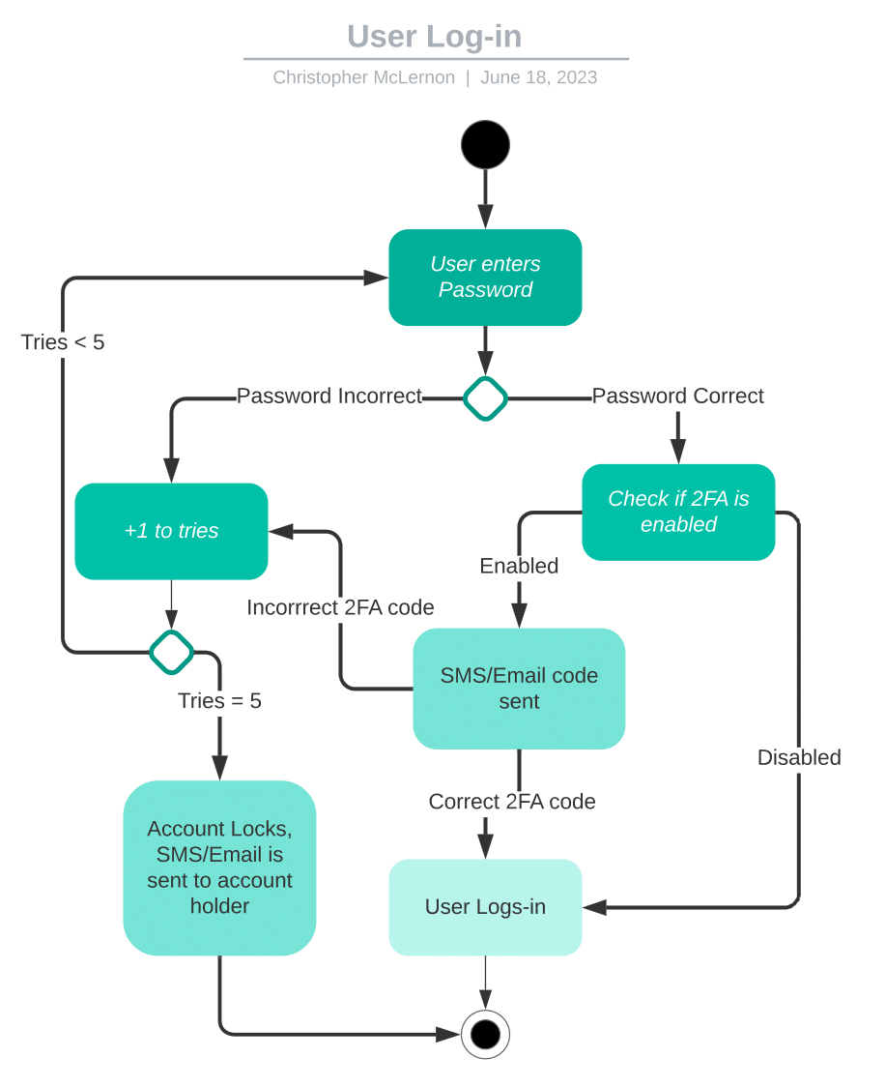
Activity Diagram
Notes:
This is a breakdown of the process of a user logging in
The user enters their login credentials
This then is verified by the server running the DriverPass system
if incorrect the user has 5 tries before being locked out
if correct the system checks if the user has 2 factor authentication
if the user has 2 Factor authentication
a code is sent to their SMS/Email
This helps to improve security by requiring the user to have access to their phones or emails depending on the authentication service
If the user enters an incorrect Code it bounces them back to the log-in screen
if they enter the correct code They are successfully logged in

Slide 5
Security
Having 2 Factor authentication
Unique username and passwords
secure server handling
external secure payment services
Notes:
Users provide information to the secretary and create a username and password for login.
The system admin monitors activities during the account creation process.
Cloud infrastructure securely exchanges data between the client and server, ensuring efficient communication.
Users have the option to follow instructions for a password reset if they forget their password.
The IT admin is responsible for detecting and addressing hacking attempts.
The system admin receives notifications for system movements, enhancing security measures.
In summary, login involves contacting the secretary, providing information, and creating a username and password.
The cloud infrastructure guarantees secure data exchange.
Password reset instructions are readily available for users.
The IT and system admins actively maintain security and monitor system movements to enhance the user experience.

Slide 6
System Limitations
System design limitations: time, budget, and human resources.
Five-month time constraint may impact feature scope.
Assumption of no budget availability may restrict necessary resource acquisition and scalability.
Design acknowledges need for additional employees without specifying number or expertise.
Agile approach recommended to address limitations.
Agile methodologies prioritize adaptability, collaboration, and iterative development.
Agile allows flexibility within time and resource constraints.
Notes:
Time limitation: The system design is constrained by a five-month timeframe for development.
Impact on feature scope: The limited time available may restrict the number and complexity of features that can be developed within the given timeframe.
Budget limitation: The assumption is that there is no budget available for the project.
Resource acquisition restriction: The lack of budget availability may impede the acquisition of necessary resources, such as hardware, software, or external services, which could impact the system's scalability and functionality.
Need for additional employees: The design recognizes the need for more employees to support the development process.
Lack of specifics: However, the design does not provide details regarding the number or expertise required, leaving room for ambiguity and potential inefficiencies in development.
Recommended agile approach: To overcome these limitations, an agile approach is recommended.
Adaptability: Agile methodologies prioritize adaptability, allowing for adjustments to be made during the development process to accommodate changes and constraints.
Collaboration: Agile emphasizes collaboration between team members, enabling effective communication and coordination to tackle challenges and make collective decisions.
Iterative development: Agile promotes iterative development, where the system is built incrementally, allowing for continuous feedback, testing, and improvement.
Flexibility within constraints: Agile provides flexibility within time and resource limitations, enabling the team to prioritize and deliver the most valuable features within the given constraints.

